Slide 1
Domain ML
Technology: Python
MACHINE LEARNING-BASED ANALYSIS OF CRYPTO CURRENCY MARKET FINANCIAL RISK MANAGEMENT

Slide 2
INDEX
Abstract
Problem Statement /Objective
Introduction
Existing Method
Disadvantage
Proposed method
Flow Diagram
Advantages
Algorithms
Hardware and Software Requirements
Modules
Architecture
UML Diagram
Screens
Conclusion
References

Slide 3
OBJECTIVE
The main objective of machine learning-based analysis of cryptocurrency market financial risk management is to develop models and algorithms that can effectively analyze market data, identify patterns and trends, and predict financial risks associated with cryptocurrency investments. The goal is to enhance decision-making and mitigate potential risks for investors and financial institutions operating in the cryptocurrency market.
PROBLEM STATEMENT
The problem statement of machine learning-based analysis of cryptocurrency market financial risk management is to address the challenge of accurately assessing and predicting the volatile nature of cryptocurrency markets, including price fluctuations, market manipulation, and regulatory uncertainties. The aim is to develop robust models that can provide timely and reliable risk assessments, aiding investors and financial institutions in making informed decisions and managing their exposure to financial risks in the cryptocurrency market.

Slide 4
ABSTRACT
Crypto currency is a well-known financial state in the globe, posing a variety of dangers that have an impact on the intrinsic risk assessment of risk auditors. Since its inception, the rise of crypto currencies has presented financial institutions with a wide range of risks in terms of money laundering. In the institution of financial supports such as anti-money laundering, banks, and bank secrecy, continue as a risk specialist, bank manager, and compliance officer who has a provocation for the connected transaction through crypto currencies and the users who conceal the illicit funds. In this study, the crypto currency framework was subjected to Hierarchical Risk Parity and unsupervised machine learning. The professional accounting procedure in terms of the inherent risk associated with bit-coin. The professional crypto currency experience in transaction cause the lower risk comparing the less experienced one. The Hierarchical Risk Parity gives the better output in term of returning the adjusted risk tail to get the better risk management result. The result section shows the proposed model is robust to various intervals which are re-balanced and the co-variance window estimation.

Slide 5
INTRODUCTION
Financial market is one of the complex systems that the definition of complexity didn’t get accepted from universities and this cause the agreement in term of interacting the elements of complex systems together. Complex system modeling is similar to daunting task which the structure of this system organized based on hierarchical manner that collected their own subsystems [1]–[3]. This resources extracted by the name of hierarchical models. Unfortunately, in the process of portfolio construction there is a hug challenge regarding the lack of correlation matrix in hierarchical structure. This issue worsen the matrices for large covariance. In recent decades, around 2500 type of cryptocurrencies which contains the 252.5 trillion dollar of trading in this market [4]–[6]. The cryptocurrency reverberation transpire in, out of order environment [7]–[10]. Even news publishers had more interest and closer attention to the price changes and the large remote of actions to the soar unmitigated. Rules set up is for investors protecting and try to stop the money laundry. Similarly, stop the crowd for the fiat currency. Regarding all the mentioned good wills, implementation and theories shows the dedicated movement of price of cryptocurrency market. Lahre et al.

Slide 6
Markowitz optimization with the high ratio. Walid et al. [15] proposed the relationship between cryptocurrencies based on the highest frequency. The presented system gives the output of useful marketing insights and gives the allowance to the agent to improve the system stability. Platanakis et al. [16], demonstrates the estimation error in term of return estimation rather than naively diversified (1/N) strategy. Similarly, they used [17] the model of Black Litterman based on the variance constraints to support the sophisticated portfolio technique for estimation control of the simple methods to manage the cryptocurrency. Saba et al. [18] applied the wavelet-based analysis for cryptocurrency multi-scale dynamic interdependence between the liquid cryptocurrencies to count the traders and investors heterogeneous behaviour. Corbet et al. [19] compare the different rules of trading in term of average-oscillator to breakout the range of trading strategies. Based on the reports of cryptocurrency related audit considerations and Chartered Professional Accountants Cananda (CPAC), building the general awareness for the intrinsic risks of the ecosystem of digital assets recommended. I

Slide 7
Literature survey:
S. No | Journal Type with year | Authors | Title | Outcomes
1 | Conference ICT, Jan. 2018, pp. 1–6. | C. Y. Kim and K. Lee, | ‘‘Risk management to cryptocurrency exchange and investors guidelines to prevent potential threats,’’ | Investment and interest in cryptocurrency
2 | Conference , vol. 9, no. 9, p. 163, Sep. 2021 | ]. I. U. Haq, A. Maneengam, S. Chupradit, W. Suksatan, and C. Huo | ‘‘Economic policy uncertainty and cryptocurrency market as a risk management avenue: A systematic review,’’ | Cryptocurrency literature
3 | ” Conference , vol. 68, no. 3, pp. 12–13, 2021 | J. Gold and S. D. Palley | ‘‘Protecting cryptocurrency assets,’’ | cryptocurrency wallets
4 | Conference vol. 24, no. 1, pp. 95–118, Jun. 2021. | I. Barkai, T. Shushi, and R. Yosef | ‘‘A cryptocurrency risk–return analysis for bull and bear regimes,’’ | bitcoin, litecoin, ripple, and ethereum

Slide 8
EXISTING SYSTEM
Due to a lack of understanding of data visualization, it is a bit difficult to deploy machine learning algorithms in the present version of the system. The two management portfolio algorithms and the basic principles DQN of the trading system, which are the most often used benchmarks in this field, have been deployed to compare the RL to previous research studies. The proposed RL and neural network styles are compared to other studies that were published in terms of bit-coin risk management.
Disadvantages:
High complexity.
Time consuming.

Slide 9
PROPOSED SYSTEM
The proposed system aims to utilize machine learning techniques, specifically Linear Discriminant Analysis (LDA) classifier, for analyzing financial risk in the cryptocurrency market. LDA will be employed to identify patterns and correlations within the market data to assess potential risks. The system will collect and process a diverse set of cryptocurrency market data, including historical prices, trading volumes, and market sentiment indicators. It will train the LDA classifier on this data to classify and predict the likelihood of financial risk events, such as price fluctuations or market crashes. The results will assist in effective risk management strategies and decision-making for cryptocurrency market participants. The system's comprehensive analysis aims to enhance the understanding and management of financial risks associated with cryptocurrencies.
Advantages:
Highest accuracy
Reduces time complexity.
Easy to use

Slide 10
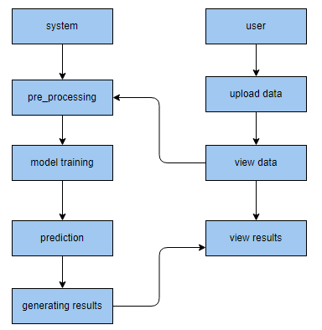
PROPOSED METHOD

Slide 11
ALGORITHMS
LINEAR DISCRIMINANT ANALYSIS :
The Linear Discriminant Analysis (LDA) classifier is a statistical technique used in machine learning and pattern recognition for classification tasks. LDA is a supervised learning algorithm that aims to find a linear combination of features that maximizes the separation between different classes while minimizing the variance within each class.In LDA, the input data is represented by a set of features, and the goal is to find a projection that maximizes the ratio of between-class scatter to within-class scatter. This is achieved by calculating the scatter matrices for each class and then combining them to form a single matrix. The eigenvectors and eigenvalues of this matrix are computed, and the eigenvectors corresponding to the largest eigenvalues are used as the projection vectors.To classify new data points, LDA projects them onto the learned projection vectors and assigns them to the class with the nearest centroid. The centroids are calculated by taking the mean of the projected samples from each class. LDA assumes that the data follows a Gaussian distribution and that the covariance matrices of all classes are equal. It also assumes that the classes have the same prior probability.

Slide 12
ALGORITHMS
Multi-Layer Perceptron Classifier:
The MLP (Multi-Layer Perceptron) classifier is a type of artificial neural network widely used for supervised learning tasks such as classification. It is composed of multiple layers of interconnected nodes, or artificial neurons, which work together to make predictions based on input data.The first layer of the MLP is the input layer, which receives the initial data. The subsequent layers are called hidden layers, and the final layer is the output layer. Each neuron in a layer is connected to every neuron in the next layer, forming a fully connected network. The connections between neurons have associated weights that determine the strength and importance of the connection.During the training process, the MLP adjusts the weights of the connections to optimize its performance. This is done using a technique called backpropagation, which calculates the gradient of the loss function with respect to the weights and updates them accordingly. The activation function is applied to each neuron's weighted sum of inputs to introduce non-linearity and enable the model to learn complex relationships.

Slide 13
ALGORITHMS
CONVOLUTIONAL NEURAL NETWORK
A CNN (Convolutional Neural Network) classifier is a type of deep learning model commonly used for image classification tasks. It is designed to automatically learn and recognize patterns in images, making it highly effective in tasks such as object recognition, facial recognition, and image classification.At its core, a CNN consists of multiple layers, including convolutional layers, pooling layers, and fully connected layers. The convolutional layers perform the main feature extraction by applying a set of learnable filters to the input image, capturing local patterns and features such as edges, textures, and shapes.The pooling layers reduce the spatial dimensions of the feature maps, allowing the network to focus on the most salient features while also providing some degree of translational invariance. This means that the network can recognize patterns regardless of their position in the image.Once the feature extraction and pooling stages are complete, the fully connected layers are employed to perform the classification. These layers take the high-level features obtained from the previous layers and map them to the corresponding classes or labels.

Slide 14
ALGORITHMS
Extra Tree Classifier:
Extremely Randomized Trees Classifier (Extra Trees Classifier) is a type of ensemble learning technique which aggregates the results of multiple de-correlated decision trees collected in a “forest” to output it’s classification result. In concept, it is very similar to a Random Forest Classifier and only differs from it in the manner of construction of the decision trees in the forest.Each Decision Tree in the Extra Trees Forest is constructed from the original training sample. Then, at each test node, Each tree is provided with a random sample of k features from the feature-set from which each decision tree must select the best feature to split the data based on some mathematical criteria (typically the Gini Index). This random sample of features leads to the creation of multiple de-correlated decision trees. To perform feature selection using the above forest structure, during the construction of the forest, for each feature, the normalized total reduction in the mathematical criteria used in the decision of feature of split (Gini Index if the Gini Index is used in the construction of the forest) is computed. This value is called the Gini Importance of the feature. To perform feature selection, each feature is ordered in descending order according to the Gini Importance of each feature and the user selects the top k features according to his/her choice.

Slide 15
ALGORITHMS
HYBRID MODEL CLASSIFIER :
A hybrid model classifier combines multiple machine learning algorithms or approaches to improve the accuracy and performance of the classification task. It leverages the strengths of different models and combines their outputs to make more accurate predictions.The hybrid model classifier typically consists of two or more individual classifiers. Each classifier is trained independently using different algorithms or techniques. These individual classifiers may include decision trees, support vector machines, neural networks, or any other suitable algorithm. Each classifier is capable of capturing different aspects of the data and making predictions based on its own rules or features.Once the individual classifiers are trained, the hybrid model combines their predictions using a fusion strategy. The fusion strategy can be as simple as majority voting, where the class predicted by the majority of classifiers is selected as the final prediction. Alternatively, more sophisticated fusion strategies, such as weighted voting or stacking, can be employed to assign different weights to individual classifiers based on their performance or confidence levels.

Slide 16
HARDWARE AND SOFTWARE REQUIREMENTS
H/W Configuration:
Operating system : Windows 7 or 7+
RAM : 8 GB
Hard disc or SSD : More than 500 GB
Processor : Intel 3rd generation or high or Ryzen with 8 GB Ram
S/W Configuration:
Software’s : Python 3.6 or high version
IDE : PyCharm.
Framework : Flask, pandas, numpy and Scikit-Learn

Slide 17
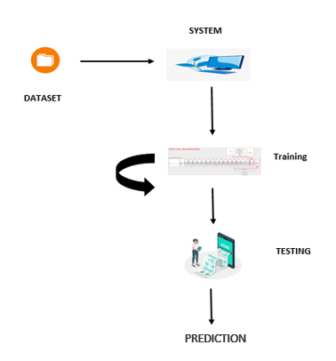
ARCHITECTURE:

Slide 18
MODULES:
User:
View Home page:
Here user view the home page of the crypocurrency application.
View about page:
In the about page, users can learn more about the crypocurrency platform.
View load_data page:
In the load_data page , the user will load the dataset for modelling.
Input Model:
The user must provide input values for the certain fields in order to get results.
View Results:
User view’s the generated results from the model.
View score:
Here user have ability to view the accuracy score in %

Slide 19
System
Working on dataset:
System checks for data whether it is available or not and load the data in csv files.
Pre-processing:
Data need to be pre-processed according the models it helps to increase the accuracy of the model and better information about the data.
Training the data:
After pre-processing the data will split into two parts as train and test data before training with the given algorithms.
Model Building
To create a model that predicts the personality with better accuracy, this module will help user.
Generated Score:
Here user view the score in %
Generate Results:
We train the machine learning algorithm and predict the result.

Slide 20
APPLICATIONS:
The applications of machine learning-based analysis of cryptocurrency market financial risk management include providing risk assessments and recommendations for individual investors, enabling them to make informed decisions and manage their cryptocurrency portfolios more effectively. Additionally, financial institutions can utilize these applications to assess and manage their exposure to cryptocurrency-related risks, aiding in regulatory compliance and risk mitigation efforts.

Slide 21
UML DIAGRAMS
UML stands for Unified Modelling Language. UML is a standardized general-purpose modelling language in the field of object-oriented software engineering. The standard is managed, and was created by, the Object Management Group.
The goal is for UML to become a common language for creating models of object-oriented computer software. In its current form UML is comprised of two major components: a Meta-model and a notation. In the future, some form of method or process may also be added to; or associated with, UML.
The Unified Modelling Language is a standard language for specifying, Visualization, Constructing and documenting the artefacts of software system, as well as for business modelling and other non-software systems. The UML represents a collection of best engineering practices that have proven successful in the modelling of large and complex systems.
The UML is a very important part of developing objects-oriented software and the software development process. The UML uses mostly graphical notations to express the design of software projects.

Slide 22
GOALS:
The Primary goals in the design of the UML are as follows:
Provide users a ready-to-use, expressive visual modelling Language so that they can develop and exchange meaningful models.
Provide extendibility and specialization mechanisms to extend the core concepts.
Be independent of particular programming languages and development process.
Provide a formal basis for understanding the modelling language.
Encourage the growth of OO tools market.
Support higher level development concepts such as collaborations, frameworks, patterns and components.
Integrate best practices.

Slide 23
USE CASE DIAGRAM
A use case diagram in the Unified Modeling Language (UML) is a type of behavioral diagram defined by and created from a Use-case analysis.
Its purpose is to present a graphical overview of the functionality provided by a system in terms of actors, their goals (represented as use cases), and any dependencies between those use cases.
The main purpose of a use case diagram is to show what system functions are performed for which actor. Roles of the actors in the system can be depicted.

Slide 24
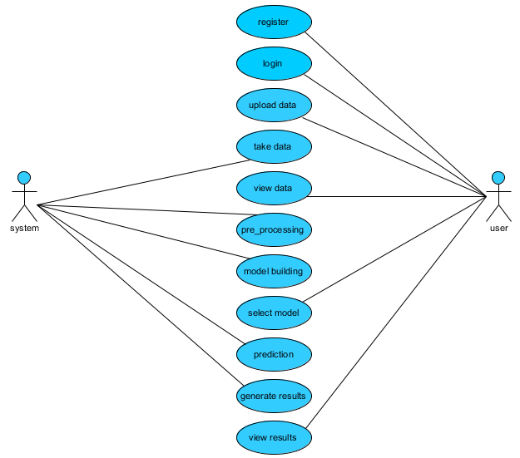

Slide 25
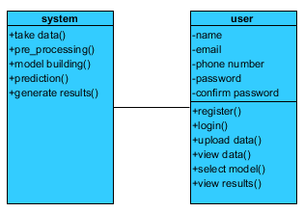
CLASS DIAGRAM
In software engineering, a class diagram in the Unified Modeling Language (UML) is a type of static structure diagram that describes the structure of a system by showing the system's classes, their attributes, operations (or methods), and the relationships among the classes. It explains which class contains information

Slide 26
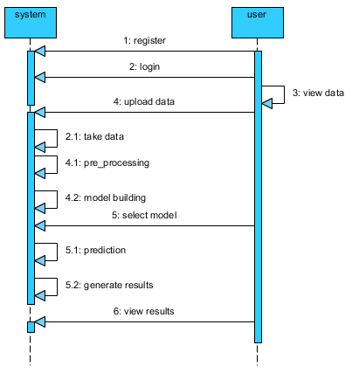
SEQUENCE DIAGRAM
A sequence diagram in Unified Modeling Language (UML) is a kind of interaction diagram that shows how processes operate with one another and in what order.
It is a construct of a Message Sequence Chart. Sequence diagrams are sometimes called event diagrams, event scenarios, and timing diagrams

Slide 27
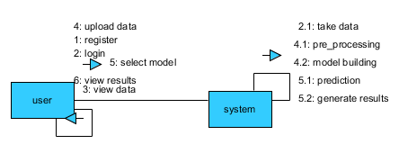
COLLABORATION DIAGRAM:
In collaboration diagram the method call sequence is indicated by some numbering technique as shown below. The number indicates how the methods are called one after another. We have taken the same order management system to describe the collaboration diagram. The method calls are similar to that of a sequence diagram. But the difference is that the sequence diagram does not describe the object organization whereas the collaboration diagram shows the object organization.

Slide 28
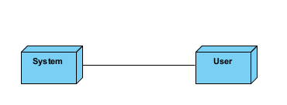
DEPLOYMENT DIAGRAM
Deployment diagram represents the deployment view of a system. It is related to the component diagram. Because the components are deployed using the deployment diagrams. A deployment diagram consists of nodes. Nodes are nothing but physical hardware’s used to deploy the application.

Slide 29
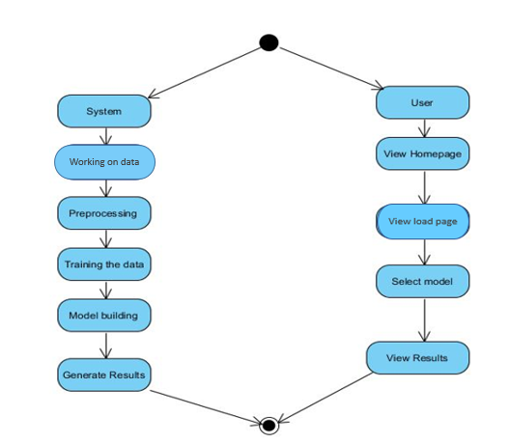
ACTIVITY DIAGRAM:
Activity diagrams are graphical representations of workflows of stepwise activities and actions with support for choice, iteration and concurrency. In the Unified Modelling Language, activity diagrams can be used to describe the business and operational step-by-step workflows of components in a system. An activity diagram shows the overall flow of control.

Slide 30
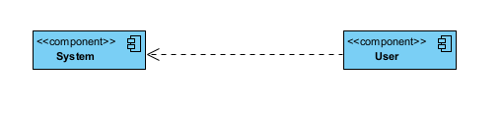
COMPONENT DIAGRAM:
A component diagram, also known as a UML component diagram, describes the organization and wiring of the physical components in a system. Component diagrams are often drawn to help model implementation details and double-check that every aspect of the system's required function is covered by planned development.

Slide 31
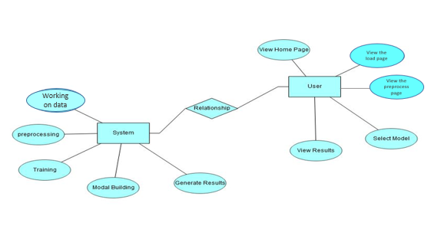
ER DIAGRAM:
An Entity–relationship model (ER model) describes the structure of a database with the help of a diagram, which is known as Entity Relationship Diagram (ER Diagram). An ER model is a design or blueprint of a database that can later be implemented as a database. The main components of E-R model are: entity set and relationship set.
An ER diagram shows the relationship among entity sets. An entity set is a group of similar entities and these entities can have attributes. In terms of DBMS, an entity is a table or attribute of a table in database, so by showing relationship among tables and their attributes, ER diagram shows the complete logical structure of a database. Let’s have a look at a simple ER diagram to understand this concept.

Slide 32
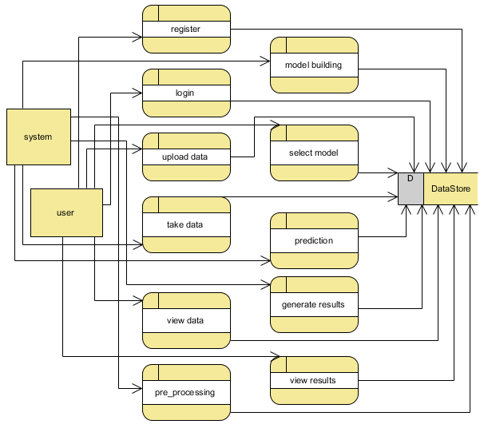
DFD DIAGRAM:
A Data Flow Diagram (DFD) is a traditional way to visualize the information flows within a system. A neat and clear DFD can depict a good amount of the system requirements graphically. It can be manual, automated, or a combination of both. It shows how information enters and leaves the system, what changes the information and where information is stored. The purpose of a DFD is to show the scope and boundaries of a system as a whole. It may be used as a communications tool between a systems analyst and any person who plays a part in the system that acts as the starting point for redesigning a system.

Slide 33
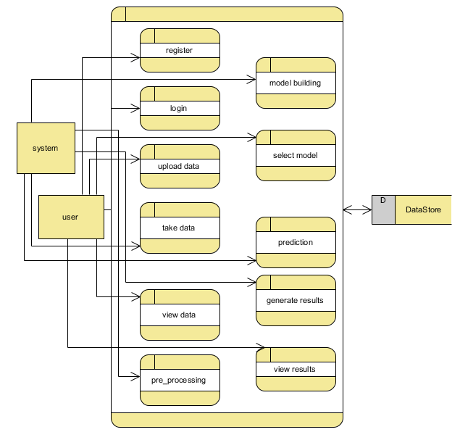

Slide 34

OUTPUT SCREENS:
Home

Slide 35
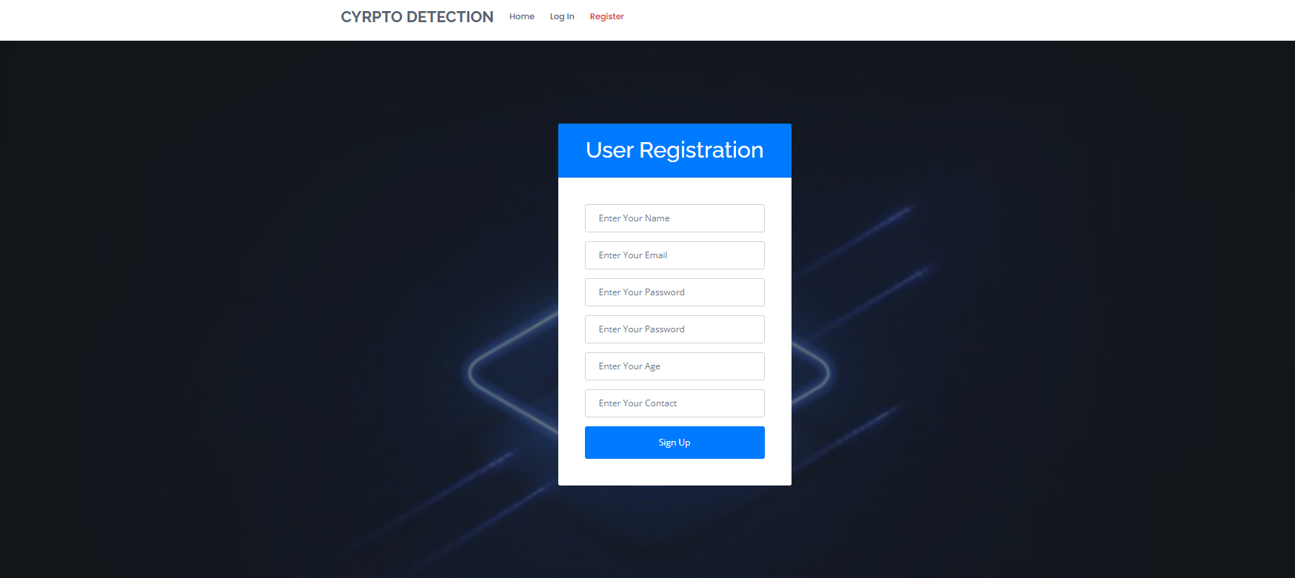
OUTPUT SCREENS:
Register

Slide 36

OUTPUT SCREENS:
Login

Slide 37

OUTPUT SCREENS:
Userhome

Slide 38

OUTPUT SCREENS:
Load

Slide 39
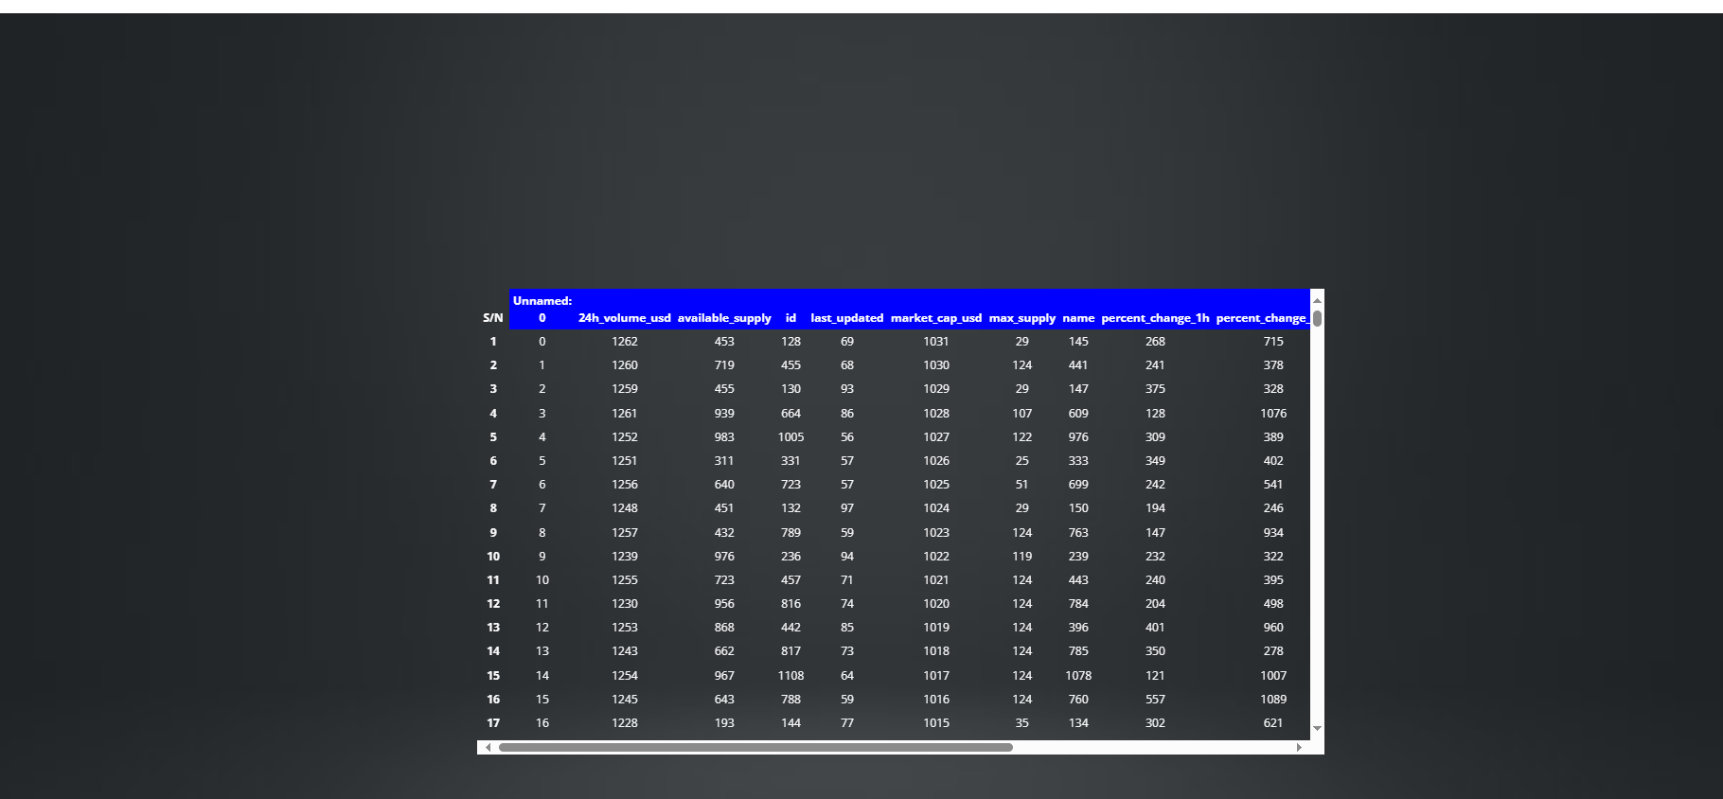
OUTPUT SCREENS:
View

Slide 40

OUTPUT SCREENS:
Model

Slide 41

OUTPUT SCREENS:
Prediction

Slide 42
CONCLUSION:
The risk management of a crypto currency network was examined in this study utilizing the Reinforcement Learning (RL) technique and an asset allocation method known as Hierarchical Risk Parity (HRP) that was applied to a crypto currency portfolio. When compared to other machine learning algorithms employed in this field, reinforcement learning produces superior performance evaluation findings. The key rationale for using RL in this process is the learning-based feature of this technique, which allows system structures to achieve high accuracy in terms of providing the correct information to the system. Furthermore, the HRP has the best features and the most desirable diversification. The data were studied utilizing multiple estimating windows and approaches, as well as re-balancing the chosen period. The implemented HRP provides a viable alternative for transitional asset allocations.

Slide 43
FUTURE SCOPE
The future scope of machine learning-based analysis of cryptocurrency market financial risk management involves the exploration of advanced techniques, such as deep learning and reinforcement learning, to improve the accuracy and predictive power of risk assessment models. Additionally, there is potential for integrating real-time market data and sentiment analysis from social media platforms to enhance the understanding of market dynamics and improve risk management strategies in the evolving cryptocurrency landscape.

Slide 44
REFERENCES:
[1] C. Y. Kim and K. Lee, ‘‘Risk management to cryptocurrency exchange and investors guidelines to prevent potential threats,’’ in Proc. Int. Conf. Platform Technol. Service (PlatCon), Jan. 2018, pp. 1–6.
[2] I. U. Haq, A. Maneengam, S. Chupradit, W. Suksatan, and C. Huo, ‘‘Economic policy uncertainty and cryptocurrency market as a risk management avenue: A systematic review,’’ Risks, vol. 9, no. 9, p. 163, Sep. 2021.
[3] J. Gold and S. D. Palley, ‘‘Protecting cryptocurrency assets,’’ Risk Manage., vol. 68, no. 3, pp. 12–13, 2021.
[4] I. Barkai, T. Shushi, and R. Yosef, ‘‘A cryptocurrency risk–return analysis for bull and bear regimes,’’ J. Alternative Investments, vol. 24, no. 1, pp. 95–118, Jun. 2021.
[5] V. Boiko, Y. Tymoshenko, R. Y. Kononenko, and D. Goncharov, ‘‘The optimization of the cryptocurrency portfolio in view of the risks,’’ J. Manage. Inf. Decis. Sci., vol. 24, pp. 1–9, Sep. 2021.

Slide 45
[6] G. Köchling, ‘‘Essays in finance: Corporate hedging, mutual fund managers’ behavior, and cryptocurrency markets,’’ M.S. thesis, Universitätsbibliothek Dortmund, Dortmund, Germany, 2021.
[7] Z. Umar, N. Trabelsi, and F. Alqahtani, ‘‘Connectedness between cryptocurrency and technology sectors: International evidence,’’ Int. Rev. Econ. Finance, vol. 71, pp. 910–922, Jan. 2021.
[8] T. Kurosaki and Y. S. Kim, ‘‘Cryptocurrency portfolio optimization with multivariate normal tempered stable processes and foster-hart risk,’’ Finance Res. Lett., vol. 45, Mar. 2022, Art. no. 102143.
[9] A. Masharsky and I. Skvortsov, ‘‘Cryptocurrency market development in Latvia and the Baltic states,’’ Eur. Cooperation, vol. 1, no. 49, pp. 7–22, 2021.
[10] S. Bhattacharya and K. Rana, ‘‘A case study on cryptocurrency driven euphoria in 2020-21,’’ Int. J. Res. Eng., Sci. Manage., vol. 4, no. 3, pp. 9–11, 2021.

Slide 46


